Slide 1


the effects of legalizing and decriminalizing prostitution

Slide 2
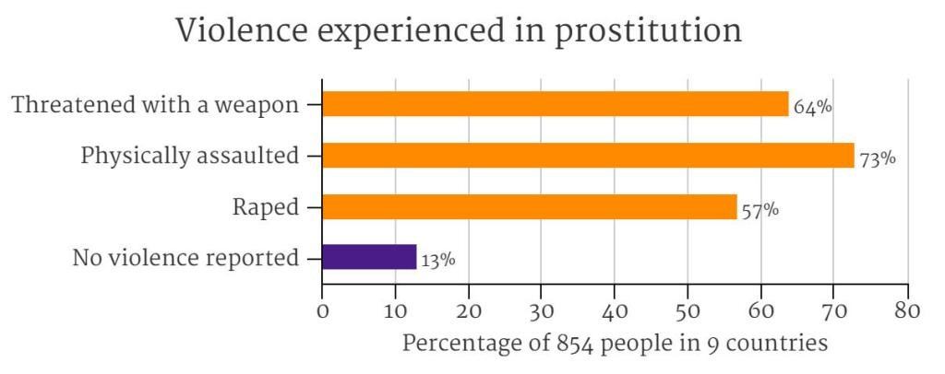
Uncontrolled prostitution is inherently violent

Slide 3
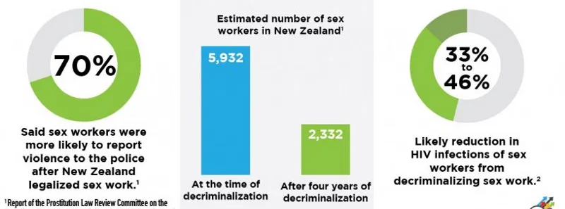
“Whenever you have an industry that is held to be legal or decriminalized, there is an safety net for those who are victims of crimes to report criminal activity,”

Slide 4
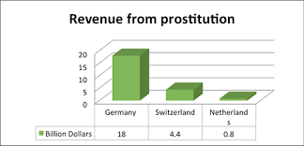

Slide 5
Who tried to treat the similar problem?

Slide 6

1.Criminalizing buyers. 2.Decriminalizing prostitutes. 3.Help. 4.Education campaign for the public

Slide 7
The Reuters - Legalizing prostitution lowers violence and disease Forbes - Why Legalizing Prostitution May Not Work Stanford researches - Legalizing Prostitution Is A 'Faustian Bargain'
Who tried to treat the similar problem?

Slide 8
Which models to use?

